Slide 1
HARBOR-QA
Bengali Question Answering with Retrieval + Few-Shot Prompting.
Shuva Dey · Priyangshu Barua | CUET | “Are You Sure LLM Is Enough?” Contest
1
Notes:
1
6/14/2026

Slide 2
The Problem
Answer short Bengali facts from 6,720 Wikipedia articles.
LLMs know little Bengali Wikipedia
THE TASK
Sparse pre-training coverage — the model can't just "recall" facts.
6,720
Wikipedia articles
Answers must be tiny & exact
1,500
Median gold answer: 2 tokens. No room for fluent rambling.
test questions
Strict output format
2 tokens
Every answer must end with the Bengali daari (।).
median answer

Slide 3





How It Works — 4 Phases
Everything at inference time. Zero training.
1. Index
2. Retrieve
3. Generate
4. Refine
Get top-20 from each index. Fuse with RRF. Keep the best chunks.
Gemma-2-9B in 4-bit. 5 example Q→A pairs teach the short answer style.
"Unknown" answers? Re-ask the LLM, then fall back to span extraction.
Split articles into 55,841 chunks. Build dense (BGE-M3) + sparse (BM25) indexes.

Slide 4

Hybrid Retrieval
Two search engines are better than one.
RRF
fusion
Dense — BGE-M3
Sparse — BM25
Understands meaning.
Good when words differ.
Matches exact words.
Good for rare names.
Each list contributes 1/(rank+1) — simple, no tuning
Top 4 chunks → context, capped at 1,800 characters
Gold answer found in context 75.3% of the time (the "ceiling")

Slide 5
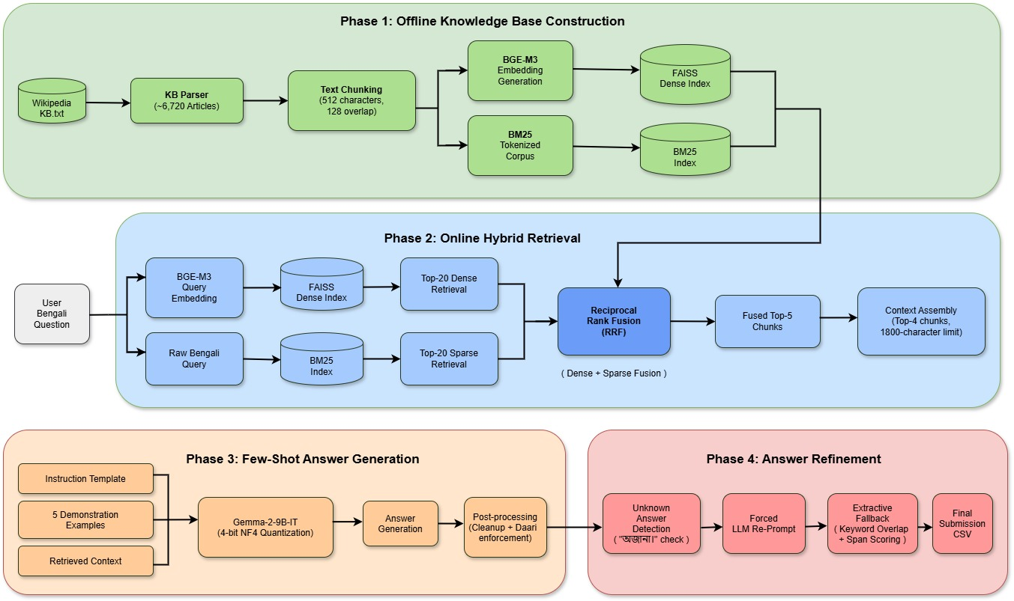
Methodology
Figure - 01 : Methodology figure

Slide 6
Small Footprint, Big Model
A 9-billion-parameter model on a free 15 GB Kaggle T4.
4-bit NF4 quantization
5 few-shot examples
Weights shrink ~4× → model fits in just 5–6 GB VRAM.
Real Q→A pairs teach the style: 1–5 words, end with daari.
Greedy decoding
Sequential memory
Deterministic, fast, batches of 8. Short facts need no beam search.
Retrieval finishes & frees the GPU before the LLM loads.

Slide 7
The 5 Few-Shot Examples
Curated Bengali Q→A exemplars sent in every prompt — each teaches: 1–5 words, end with daari (।).
Question (Bengali) | Answer (Bengali)
কালা পানি চলচ্চিত্রের সঙ্গীতায়োজন করেছেন কে? | শচীন দেববর্মণ।
মুক্তিযুদ্ধে অবদানের জন্য আবু সালেককে কী সম্মান দেওয়া হয়? | বীর প্রতীক।
ত্রিপুরার কংগ্রেস-টিইউজেএস জোট সরকার কবে গঠিত হয়? | ৫ ফেব্রুয়ারি, ১৯৮৮।
কু ওকানেজোকি নদীটির দৈর্ঘ্য কত? | ৩.৫ মিটার।
‘ডন’ শব্দটি কোন ধরনের দ্ব্যর্থতানিরসনের জন্য ব্যবহৃত হয়? | দ্ব্যর্থতা নিরসন।
Types covered: name · honour · date · numeric · disambiguation.

Slide 8
Results
Few-shot prompting on Gemma 2-9b beats QLoRA fine-tuning on Gemma 2-2b.
0.655
private-split token F1
+2.7 pts over the fine-tuned model — with no training at all.

Slide 9

Where It Wins, Where It Breaks
47.3%
31.6%
69.8%
3.8%
perfect answers
complete misses
perfect on 1-word answers
perfect on 6+ word answers
Longer answers → sharp drop. The model prefers single short entities.
Biggest failure cell: 2-word facts (dates, compound names) missed entirely.
Main causes: answer not retrieved, or the model hallucinates a lookalike.

Slide 10

Limitations & Next Steps
Retrieval ceiling: 75.3% — if the answer isn’t retrieved, it can’t be answered. Next: better chunking + a cross-encoder re-ranker.
Weak Bengali knowledge — off-context questions force guesses → hallucination. Next: morpheme-aware tokenizer for BM25 recall.
Short-answer bias — 16-token cap + terse prompting hurt long gold answers. Next: adaptive length caps by question type.
Bigger fine-tuned generator — a higher-capacity LLM (20–30B) fine-tuned with Unsloth would improve answer generation and lift the score.

Slide 11
The Takeaway
Under no-training, single-free-GPU limits, strong retrieval is the most effective route to accurate closed-domain Bengali QA.
Train nothing — retrieve well, prompt with 5 good examples
Fits a free 15 GB GPU by never loading two models at once
0.655 F1 — top of both previous approaches.

Slide 12
Thank You !

